Slide 1
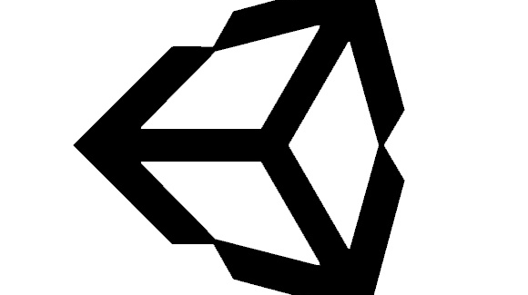
Intro to Unity – Navigation
By: Jeremy nIELSON

Slide 2
Types of Movement
There are a numbers of ways movement can be handled in VR:
Teleportation
Controller Pad Movement

Slide 3
Caution with Movement
It is common for players to feel some level of motion sickness with time while playing in VR.
The more movement/ faster the motions the player must make, the more likely motion sickness may occur
Movement using the controller pads may feel foreign to the player.
Snap camera movements as well
Test and play with the controls and provide flexibility to the user

Slide 4
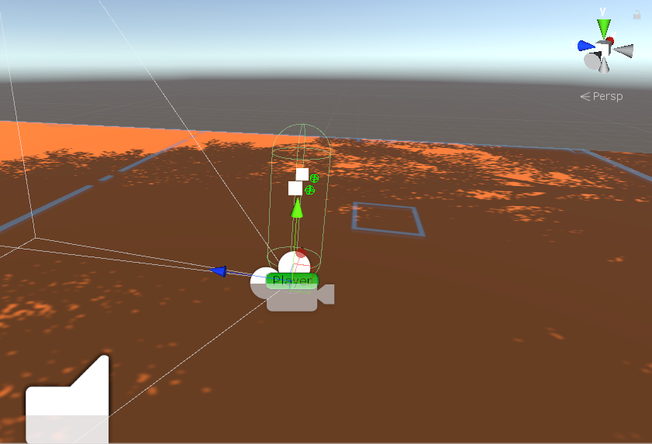
Teleporting
Quick, snap movement system
Dash movement
Fade out and in
Works well for standing, sitting, and room scale
Start by adding a player controller to the scene
Assets > SteamVR > InteractionSystem > Core > Prefabs > Player
Like the FPS controller, this will act as your player character

Slide 5
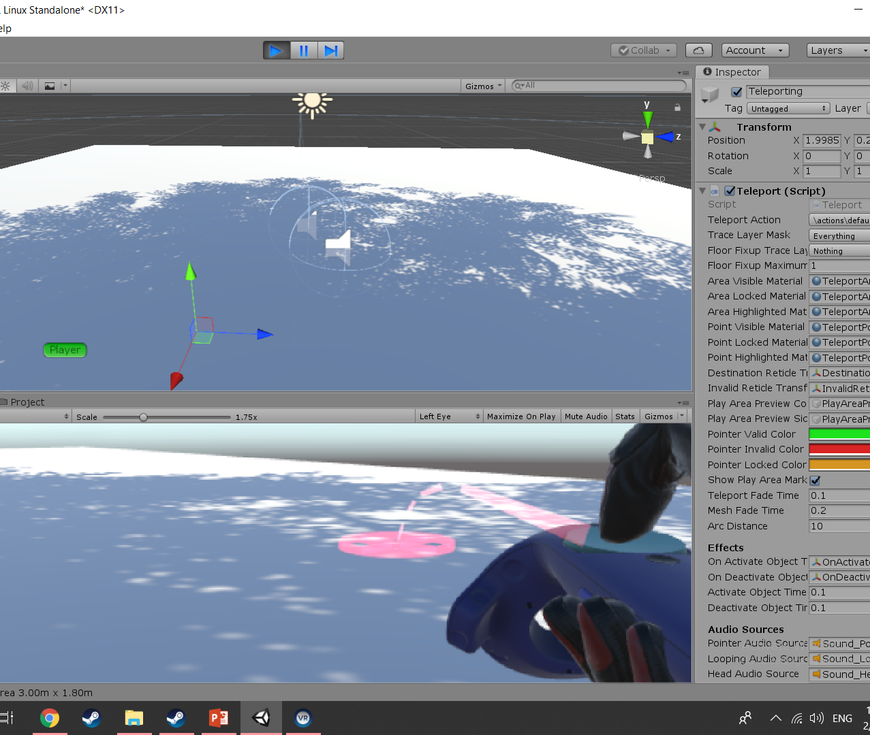
Teleporting: Getting Started
You can find the teleporting prefab under SteamVR > Interaction System > Teleport > Prefabs > Teleporting
Drag and Drop into the play area
Hop into game, should have the ability to aim
Press the middle button on either controller to aim.

Slide 6
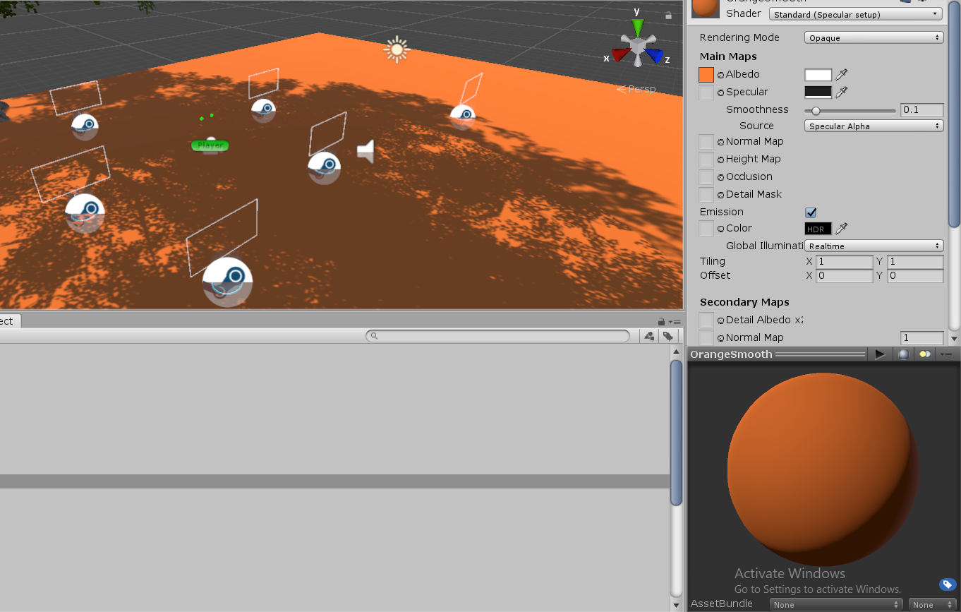
Teleporting: Teleport Points
Let’s start by making points to teleport
Under the same folder, place a TeleportPoint
Duplicate and place a couple more throughout the map
The points will blend into the white floor, due to the blue color.
To adjust this, change the floor to a different color
In the Project window under Assets, there should be Sample Scene > Materials
Drag and drop the material on the floor to change its color. Select any you feel works well for you

Slide 7
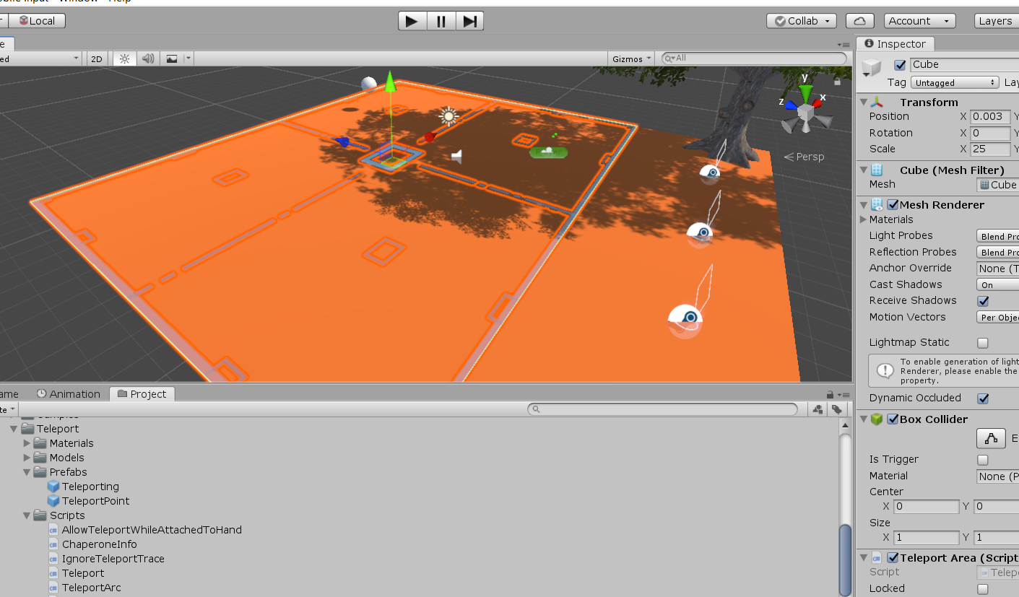
Teleporting: Teleport Area
Create a large flat cube across the play area
In the inspector panel, Add a component called “Teleport Area”
Test this out In game
You should now be able to teleport around the area as well as to each of the points

